Slide 1

Introduction to Operating Systems CS/COE 1550
Spring 2020-2021
Sherif Khattab
ksm73@pitt.edu
(Some slides are from Silberschatz, Galvin and Gagne ©2013)

Slide 2
Announcements
Upcoming deadlines:
4/2: Homework 10
4/2: Project 3 (Virtual Memory Simulator)
Tophat questions due one week after each lecture

Slide 3
Last Lecture …
Inverted Page Table
Effective Access Time calculation
Memory Management Issues
Local vs. global allocation
Page fault rate
Page size tradeoffs
Page sharing
Page locking
Effect of instruction set
etc.

Slide 4
Muddiest Points (1/3)
Project 3
hashing for opt page replacement
How to implement OPT in project 3 optimally so it doesn't time out the auto grader
for project 3 could we get an example or just more instruction on how to implement the hash table function for the opt algorithm? I don't understand how that would help the runtime or how that works at all
Memory split in project 3
Can we get some help with the OPT algorithm for project 3? I’m very confused on how to do it
More guidance on how to implement the hashtable/linked list for project3 and how to use them for opt and lru
Inverted and 2-level Page Table
I could use another rundown of the inverted table and its purpose
Why is it called inverted page table? What is inverted?
Which part of EAT cost does it save?
Indexing into the inverted page table with the hash
Pros and cons of inverted vs multi level page table
How is an inverted page table different from a regular one-level page table, both implementation- and performance-wise?
An example of translating addresses in 2 level page tables.
i think i just need to practice converting page sizes to frame number and all that again, could we maybe get more practice problems (similar to hw8 and hw9)?
Is virtual page number the index to page table?

Slide 5
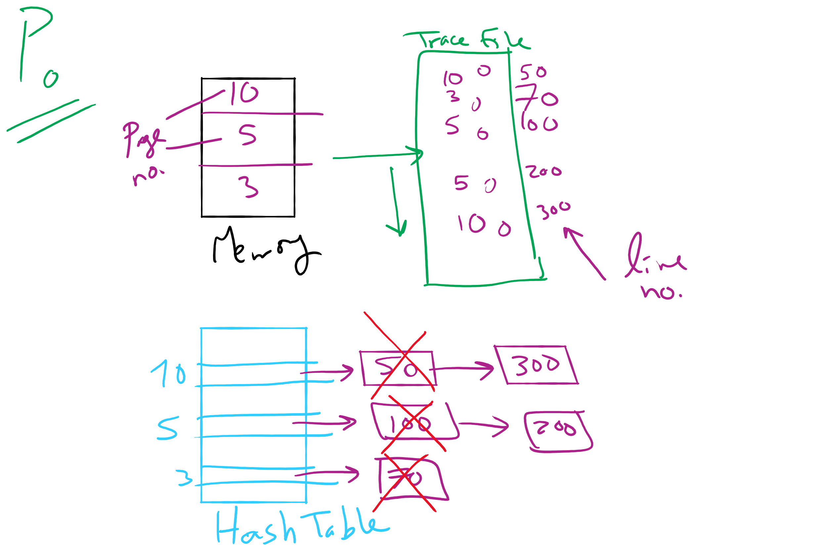
Project 3: OPT Simulation

Slide 6

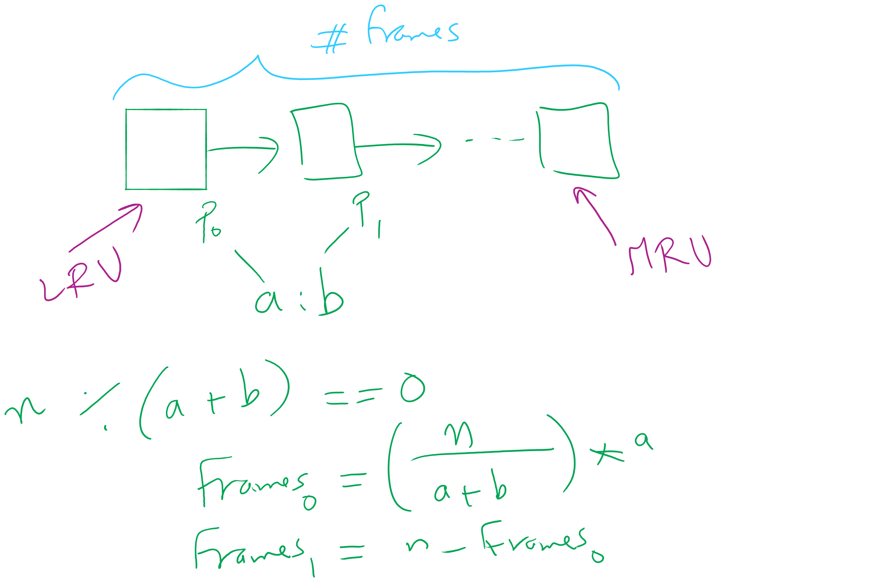
Project 3: LRU and miscellaneous hints

Slide 7
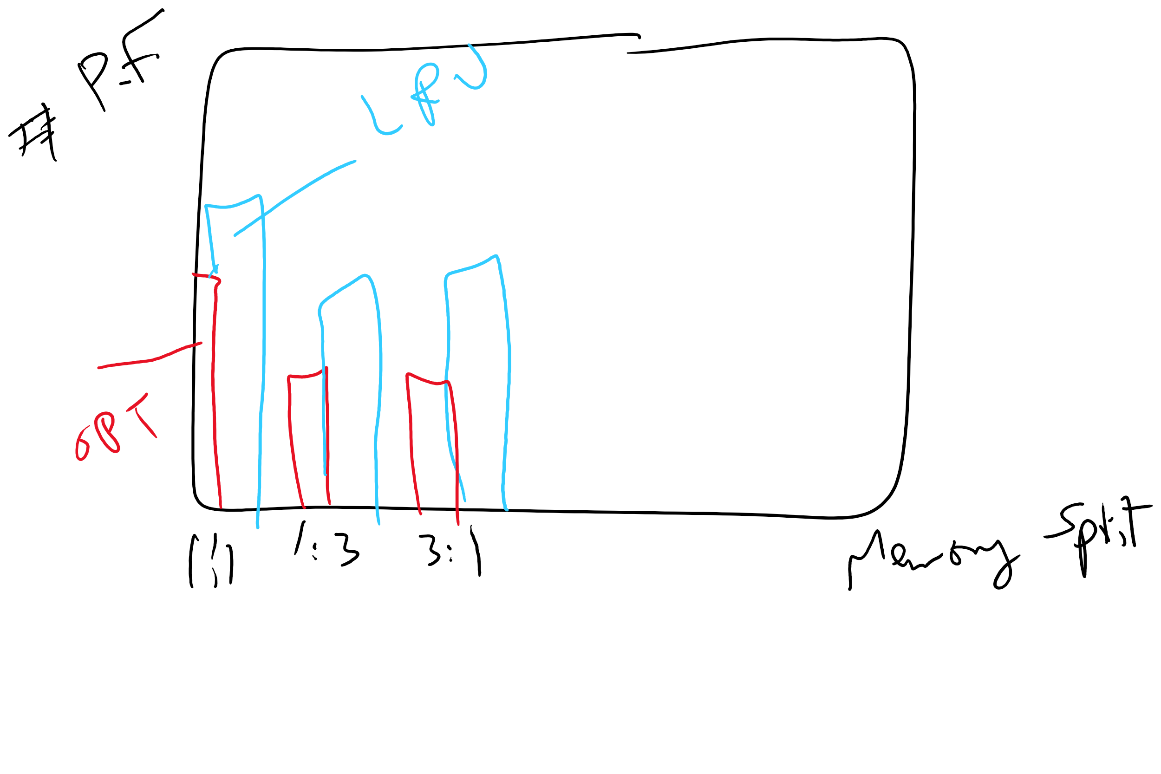
Project 3: Writeup hints

Slide 8
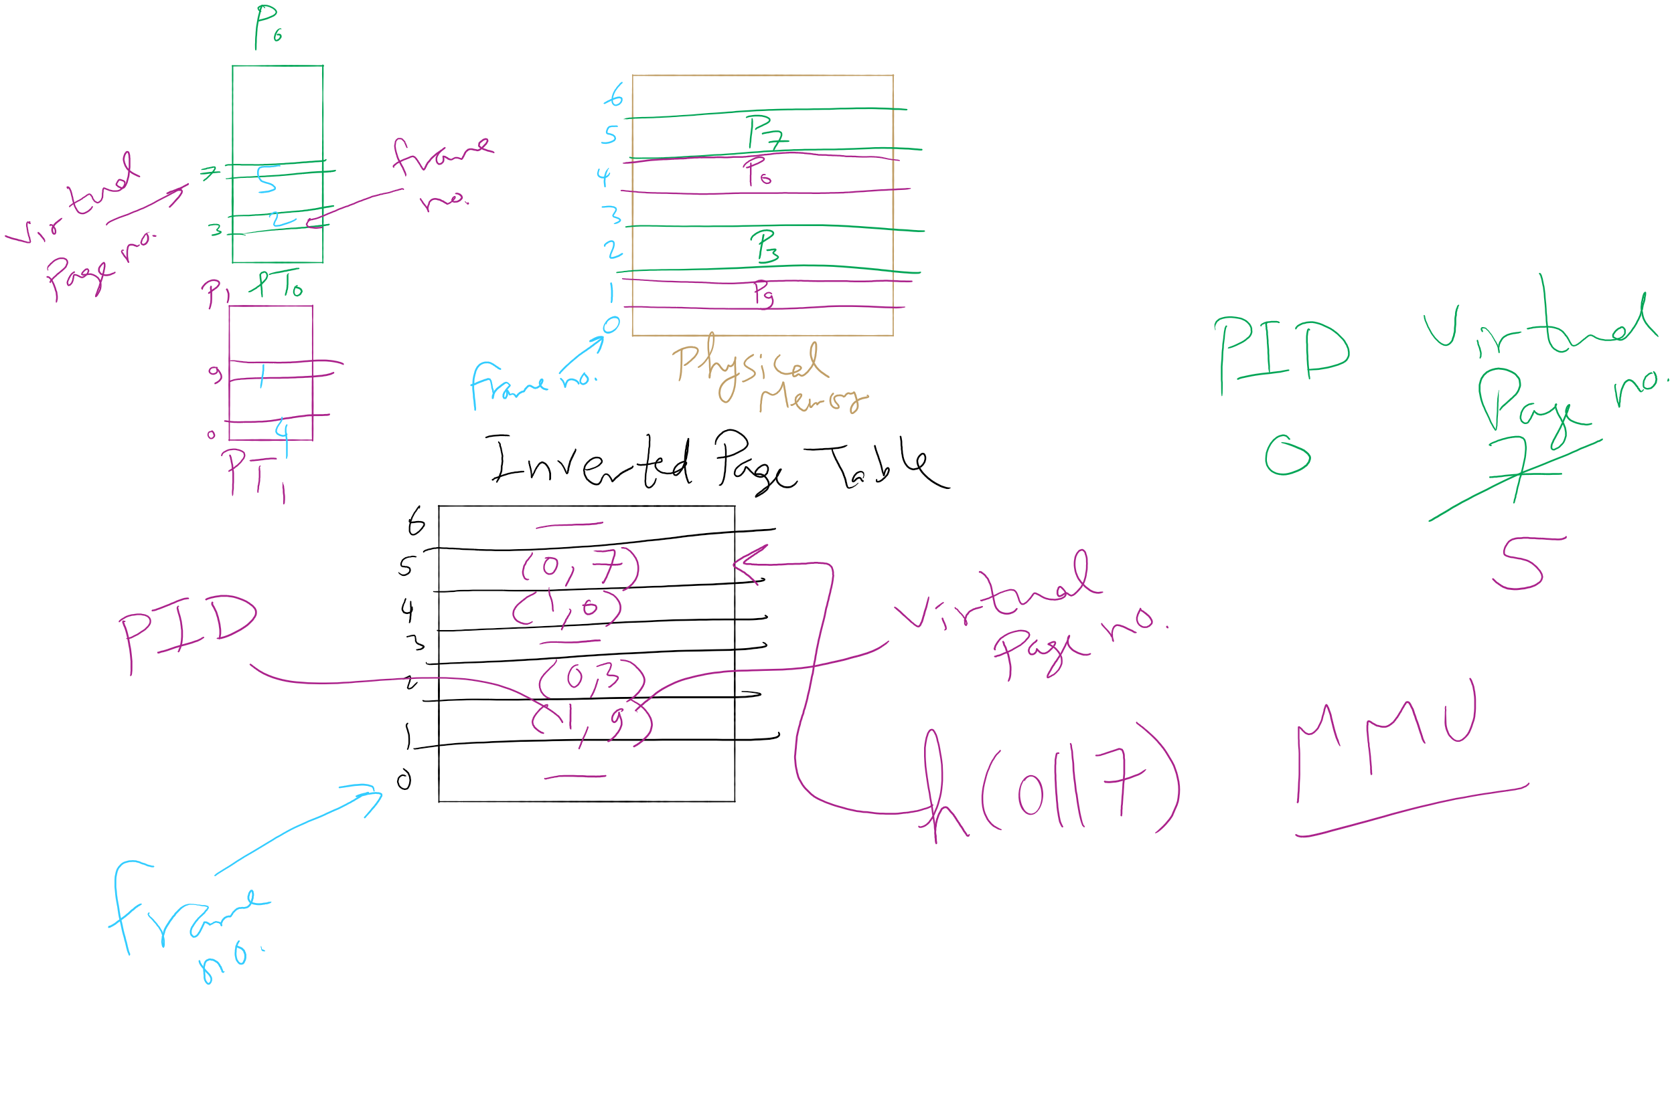
Inverted Page Table Example

Slide 9
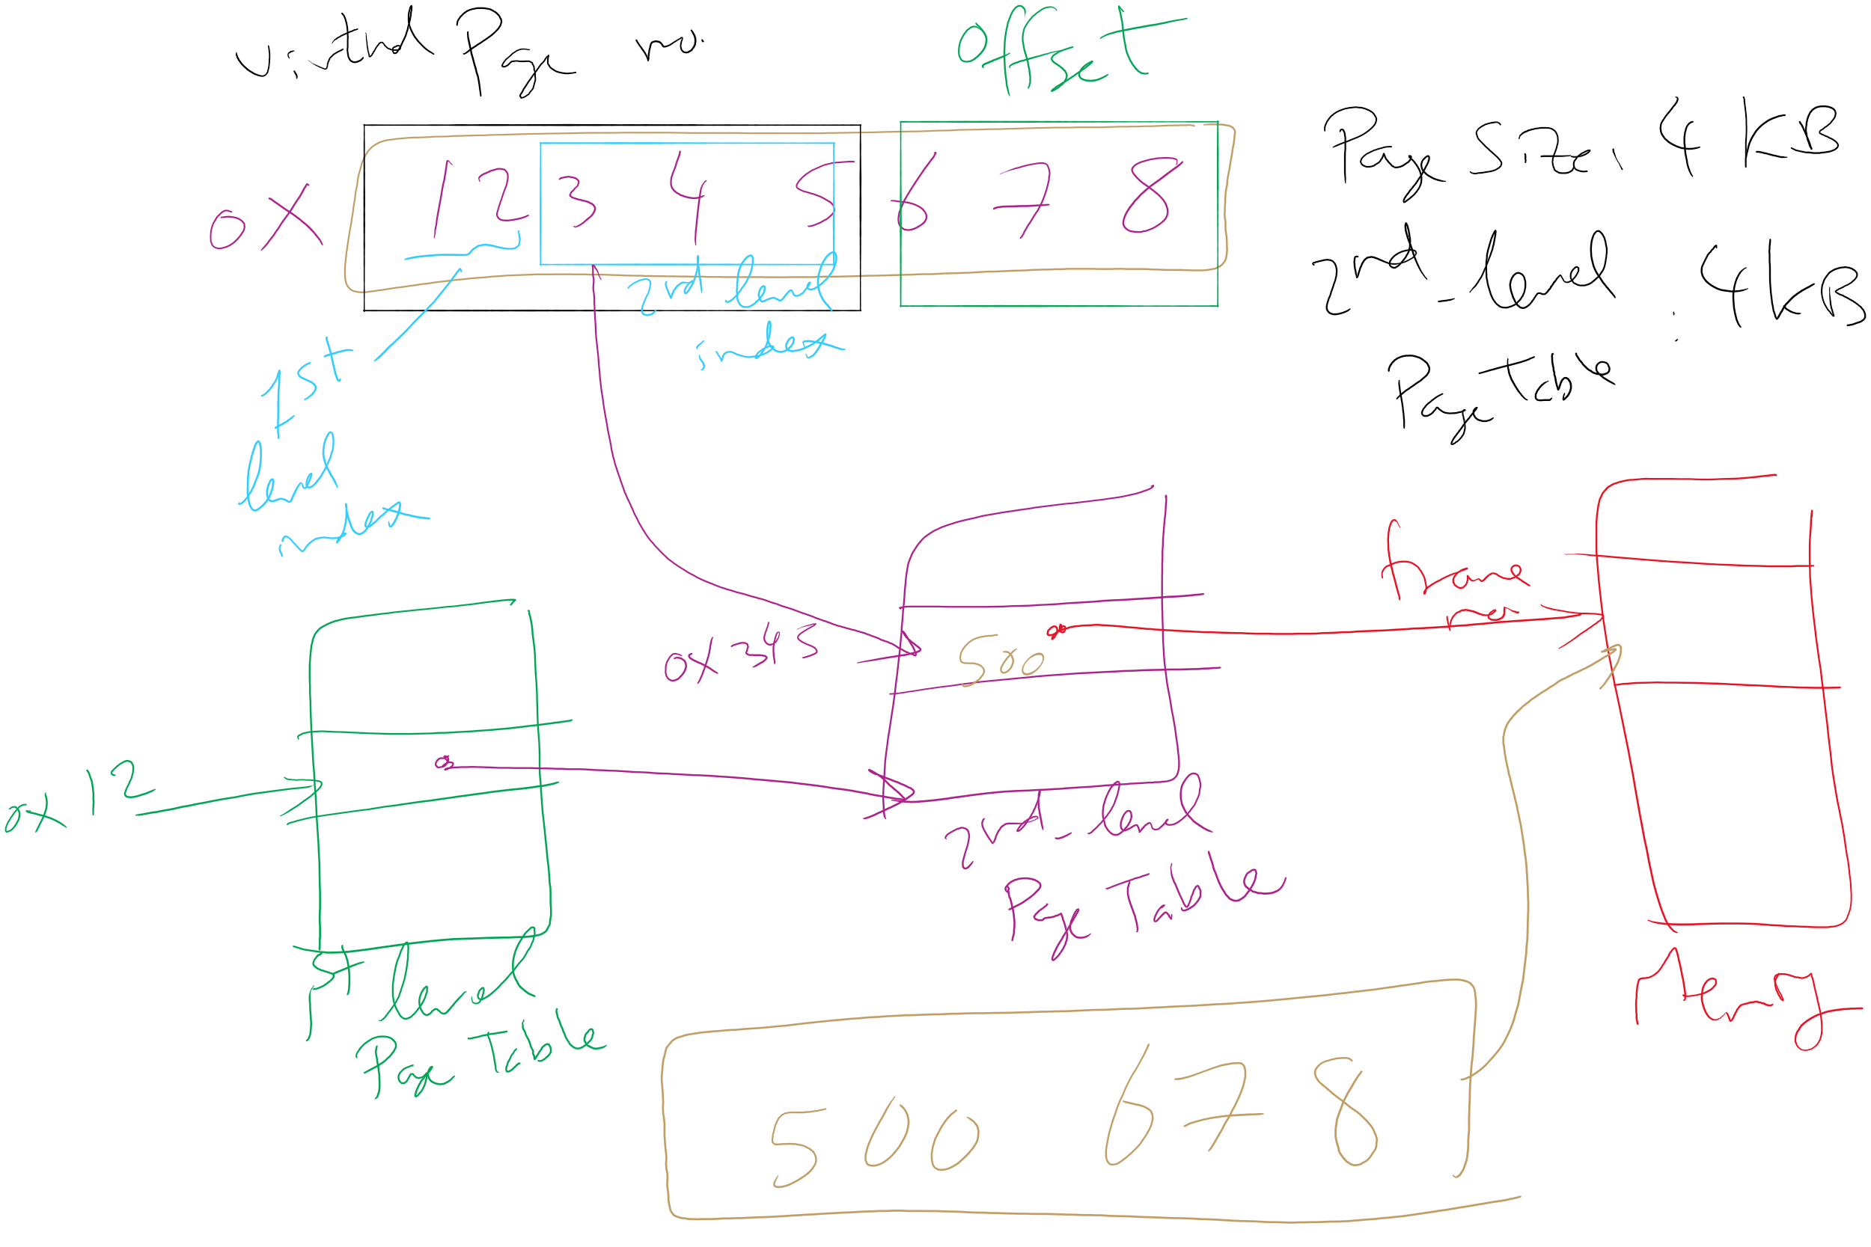
Address Translation: 2-level Page Table

Slide 10
Muddiest Points (2/3)
EAT
Why is Page Fault rate not counted as part of EAT?
EAT calculation
Sharing page is confusing.
why do we need sharing pages
What even is exchanging pointers?
more detail about share pages between multiple processes
processes sharing pages.. how do you ensure no race conditions etc?
backing up an instruction
I do not Understand the (Rd) example. Is there a way to do the same thing without getting into such trouble?
Local vs. Global allocation
I've re-watched all the past lectures but am still a bit lost (especially with the past 3-4 lecture's materials). I guess what I'm confused the most about in this lecture is how local vs global allocation policies plays a role in the wider scheme of memory management?
Also, the fact that increasing frames to the process to reduce page-fault rate seems a bit unintuitive, but that probably stems from the fact that the entire concept is a bit hazy

Slide 11
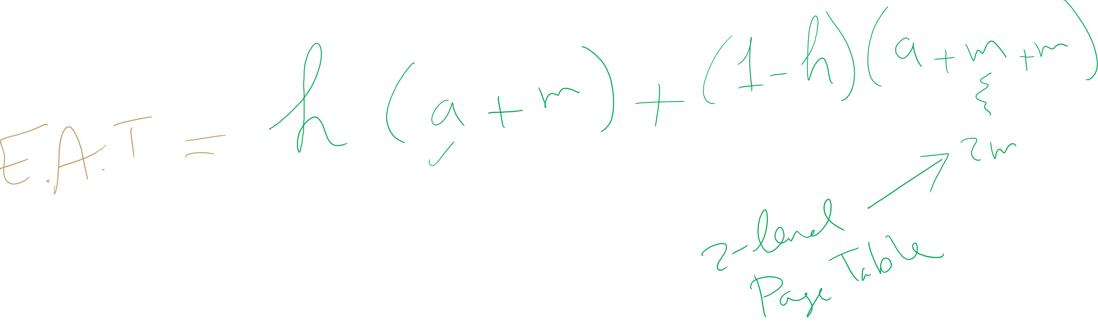
EAT Calculation

Slide 12
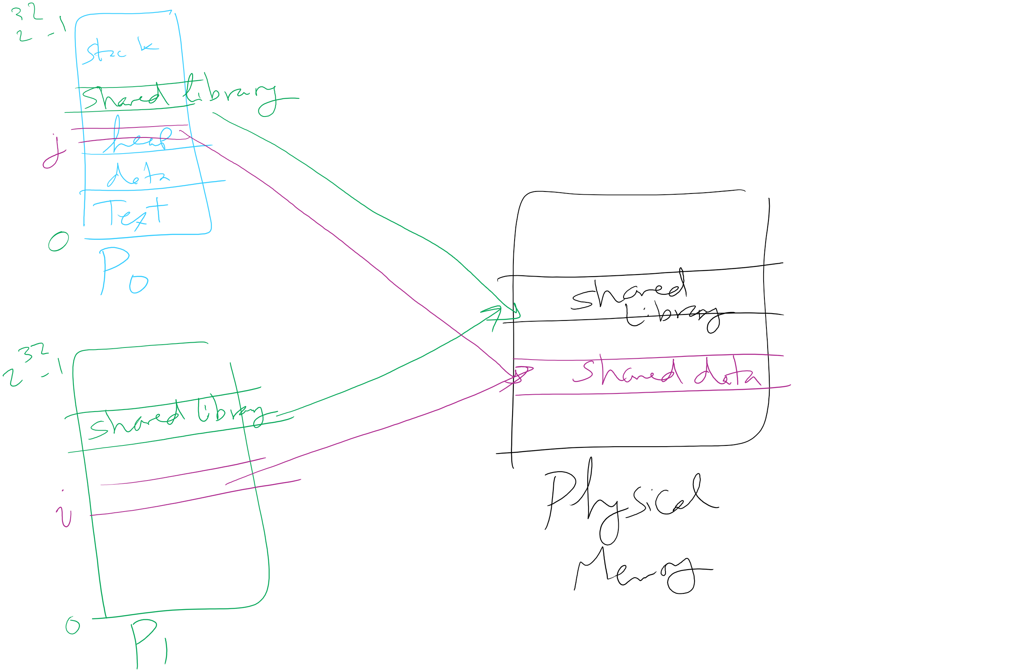
Page Sharing

Slide 13
Muddiest Points (3/3)
locking pages in memory
thrashing
What are the separate I & D address spaces a part of? Are they a portion of each page table entry? Or are they something else?
Do we ever see separate code and data address spaces used in actual architectures?
I do not think I understand any new content in this lecture...
The first TH question, I didn't really understand the explanation of the correct answer
I think that a map or layout of how processes, page tables, tlb, etc. all interact would be helpful
Lab 3 tips

Slide 14
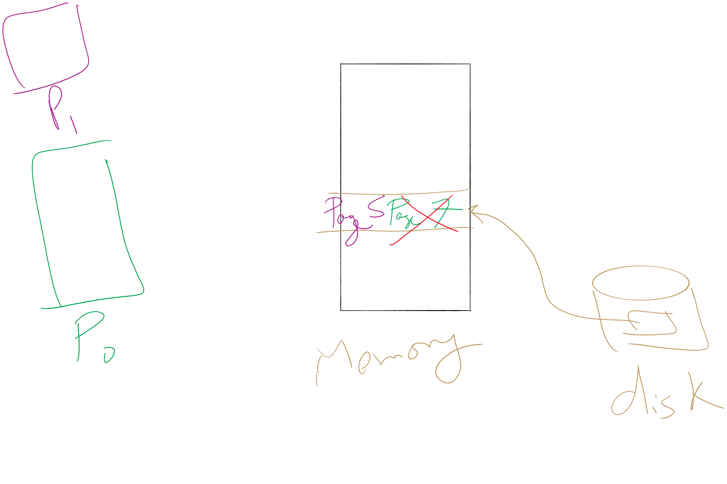
Page locking

Slide 15
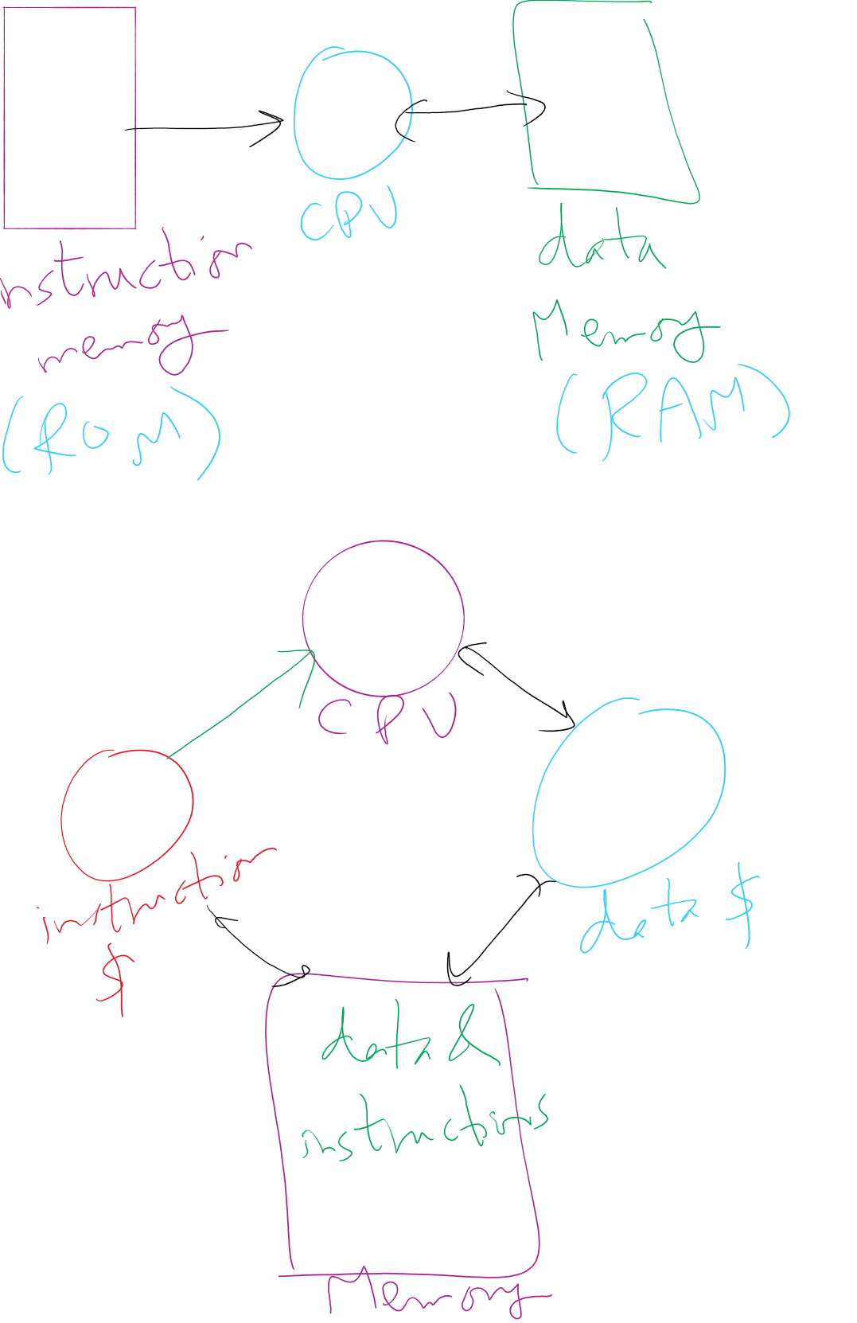
Separate I&D Address Spaces (Pure and modified)

Slide 16
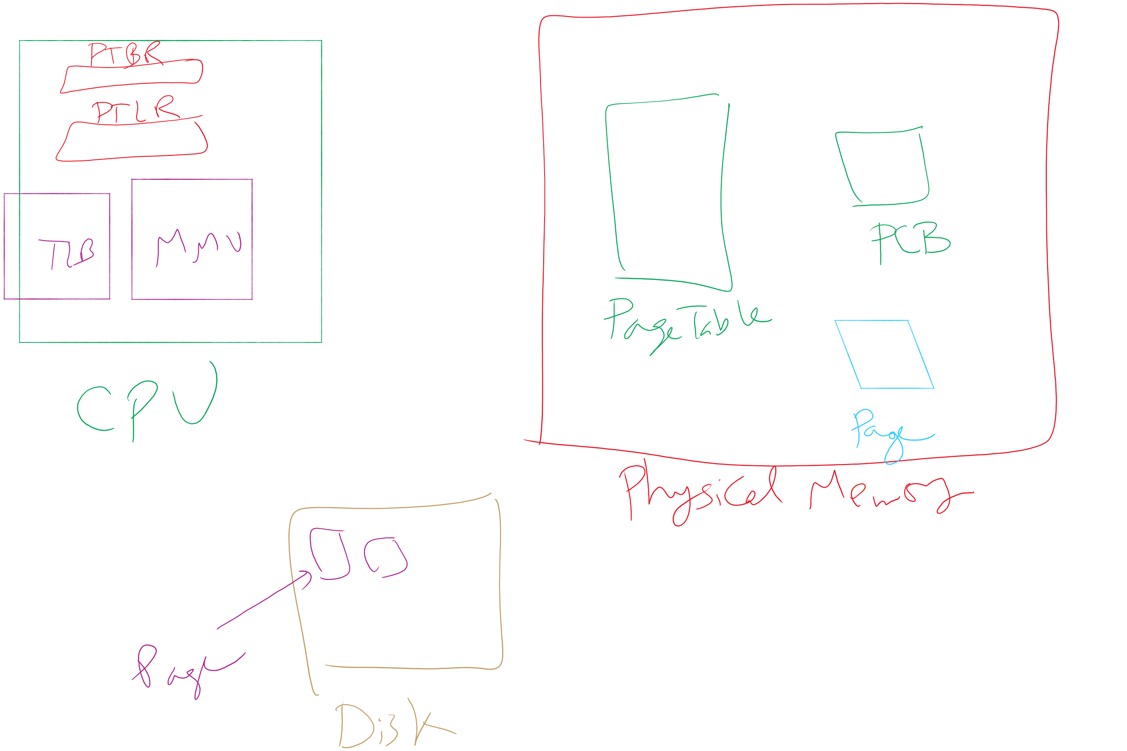
Map of MMU, TLB, Page Table, etc.

Slide 17
Today’s Agenda …
Memory Management Issues
File System Implementation

Slide 18
When are dirty pages written to disk?
On demand (when they’re replaced)
Fewest writes to disk
Slower: replacement takes twice as long (must wait for disk write and disk read)
Periodically (in the background)
Background process scans through page tables, writes out dirty pages that are pretty old
Background process also keeps a list of pages ready for replacement
Page faults handled faster: no need to find space on demand
Cleaner may use the same structures discussed earlier (clock, etc.)

Slide 19

Backing up an instruction
Problem: page fault happens in the middle of instruction execution
Some changes may have already happened
Others may be waiting for VM to be fixed
Solution: undo all of the changes made by the instruction
Restart instruction from the beginning
This is easier on some architectures than others
Example: LW R1, 12(R2)
Page fault in fetching instruction: nothing to undo
Page fault in getting value at 12(R2): restart instruction

Slide 20
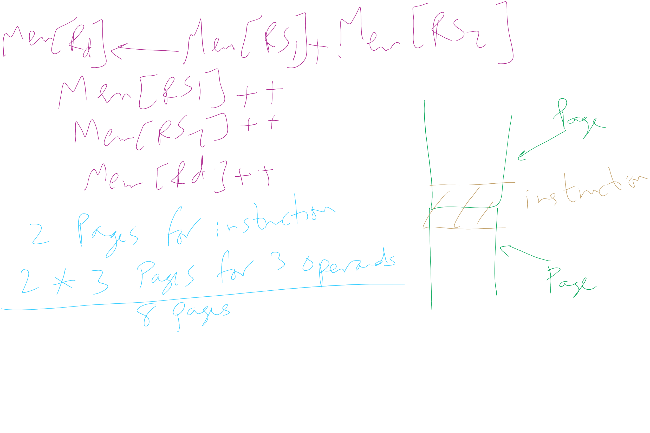
Backing up an instruction
Example: ADD (Rd)+,(Rs1)+,(Rs2)+
Page fault in writing to (Rd): may have to undo an awful lot…

Slide 21
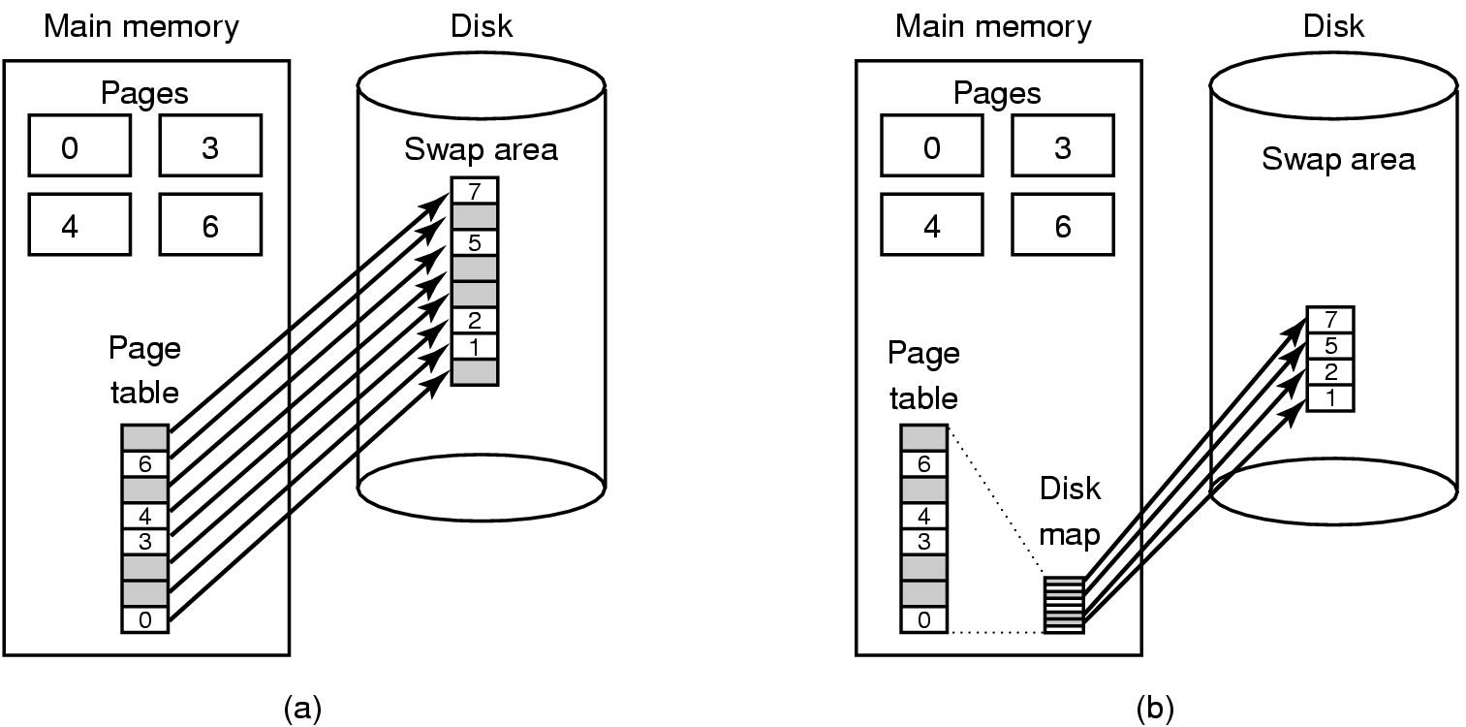
Storing pages on disk
Pages removed from memory are stored on disk
Where are they placed?
Static swap area: easier to code, less flexible
Dynamically allocated space: more flexible, harder to locate a page
Dynamic placement often uses a special file (managed by the file system) to hold pages
Need to keep track of which pages are where within the on-disk storage

Slide 22
Separating policy and mechanism
Mechanism for page replacement has to be in kernel
Modifying page tables
Reading and writing page table entries
Policy for deciding which pages to replace could be in user space
More flexibility
3. Request page
User process
External pager
4. Page arrives
User space
2. Page needed
5. Here is page!
Kernel space
Fault handler
MMU handler
1. Page fault
6. Map in page

Slide 23
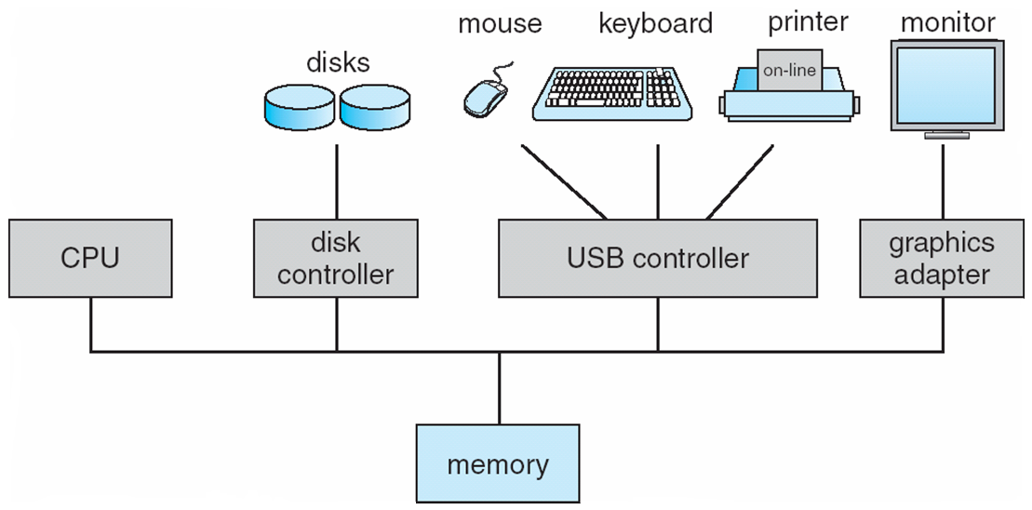
How complex is the OS’s job?
Let’s look at one of the resources managed by the OS: I/O devices

Slide 24
File system implementation issues
How are disks divided up into file systems?
How does the file system allocate blocks to files?
How are directories handled?
How does the file system manage free space?
How can the file system improve…
Performance?
Reliability?

Slide 25
Carving up the disk
Entire disk
Partition table
Master boot record
Partition 1
Partition 2
Partition 3
Partition 4
Boot block
Super block
Free space management
Index nodes
Files & directories

